Slide 1
Android SDK development
Project Title: Vital Sign Camera App
Client: WellderCare

Slide 2
Content
Project overview
Technology overview
SDK which we used
Client requirements
Implementation
Usage of App
Conclusion

Slide 3
Project Overview
VSCapp consists of Android SDK and Demo app.
Integration of SDK file from local disk
This app has backend feature camera with opencv and ARM processor
The app native script is cpp (c++ language) with Kotlin or Java
Android App version 5.1 +
Basic feature are to measure the Pulse and Respiratory
Pulse
Respiratory

Slide 4
Technology Overview
Technology : Android OS
Studio : Android Studio
Design App : Android Version 11
Camera : Opencv
Android studio we used is Bumblebee version
Open cv : Cmake version

Slide 5
SDK we used for design App
SDK version : they are two types of version
minSDKversion : 28 API (9.0 Android Version)
target Version : 32 API (11 Android Version)
NDK version :
Min NDK version : 19.2.535600
Target NDK version : 22.1.7171670
Java Version : Version 1.8 for (minimum and maximum)

Slide 6
Client Requirement
As per client requirement the App design to record the pulse and Respiratory.
App : vscapp.apk is build
Development: SDK is taken from philips and design app as per the client requirement
SDK file is uploaded to android studio and then design the app according to the client requirement.
.apk file is deploy into raspberry pi with camera

Slide 7
Implementation of Android App

Slide 8
Implementation
First step : we have to create a empty app file
In android studio go to menu:
File > project structure > Dependencies > click on +icon > import there it will appear
> gradle or eclipse > we have to give project path > ok > sync gradles.
We have to add some dependencies
Repeat process above now go to > Dependencies > app > vscapp library

Slide 9
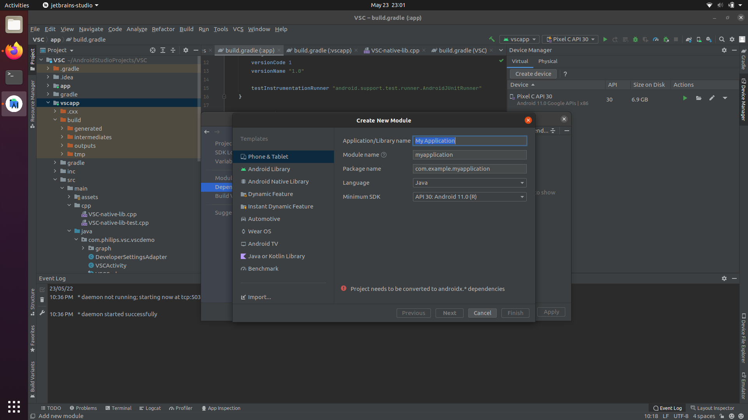

Slide 10
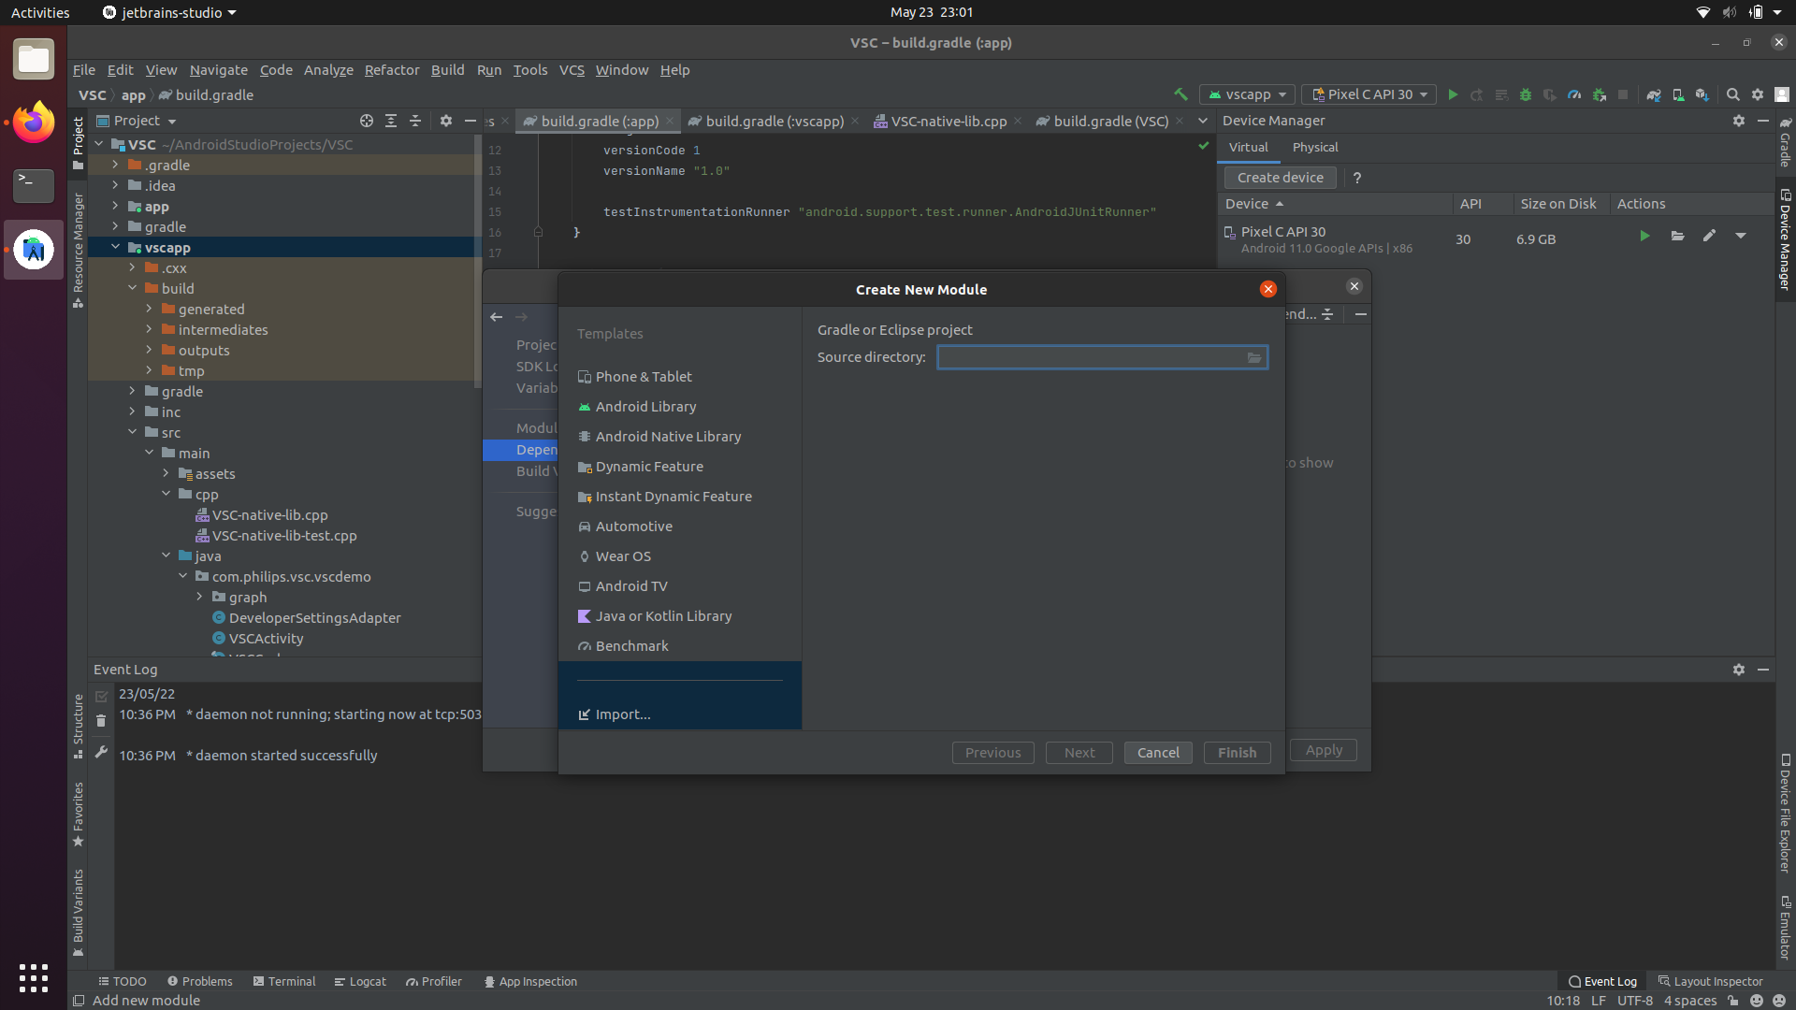

Slide 11
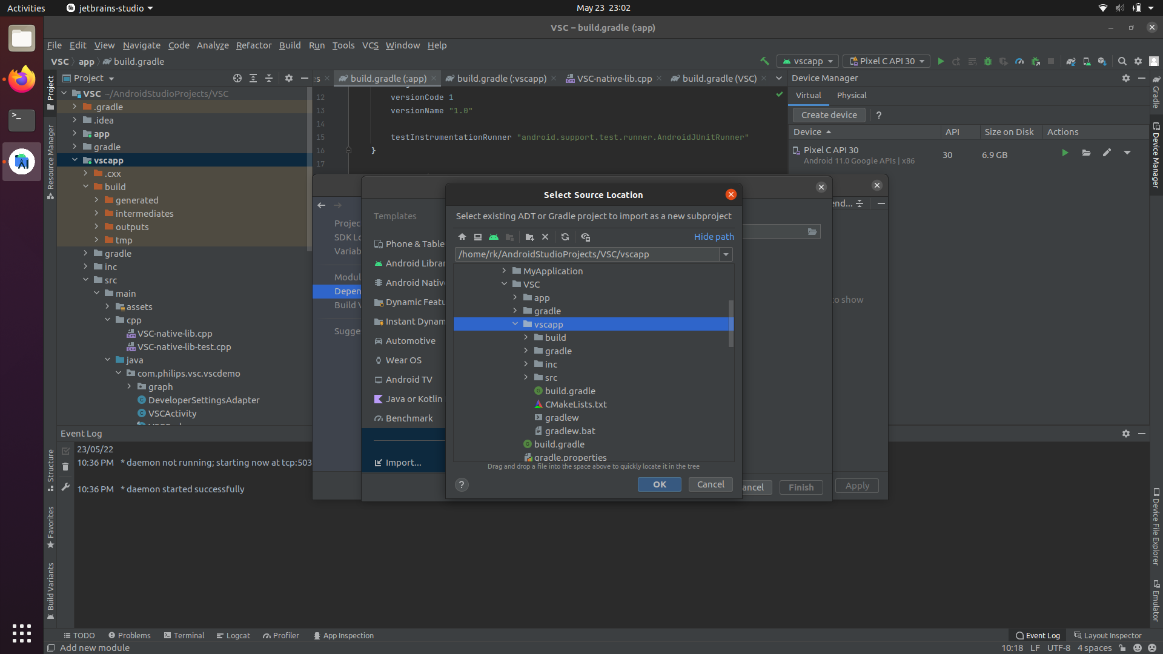

Slide 13
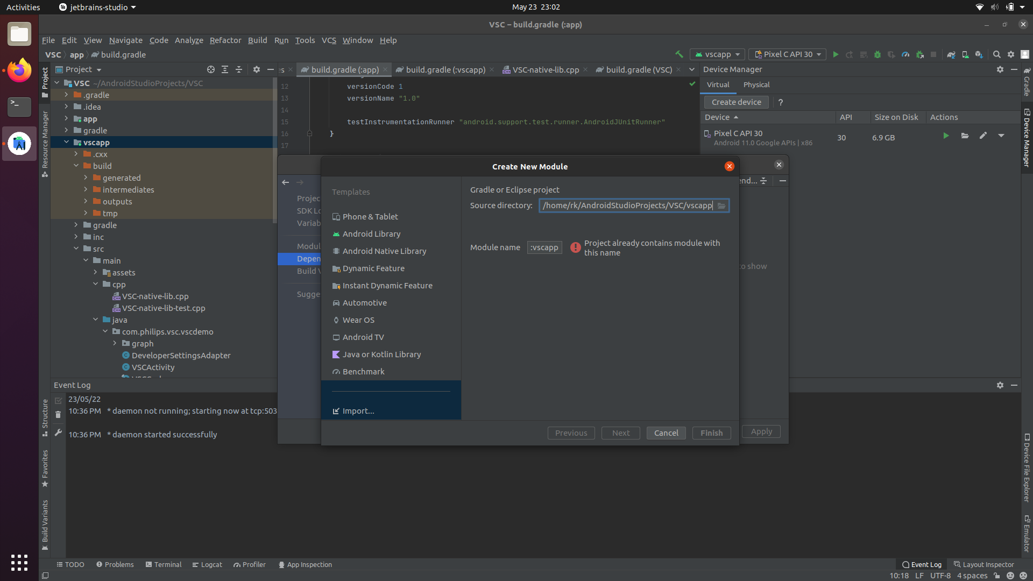

Slide 14
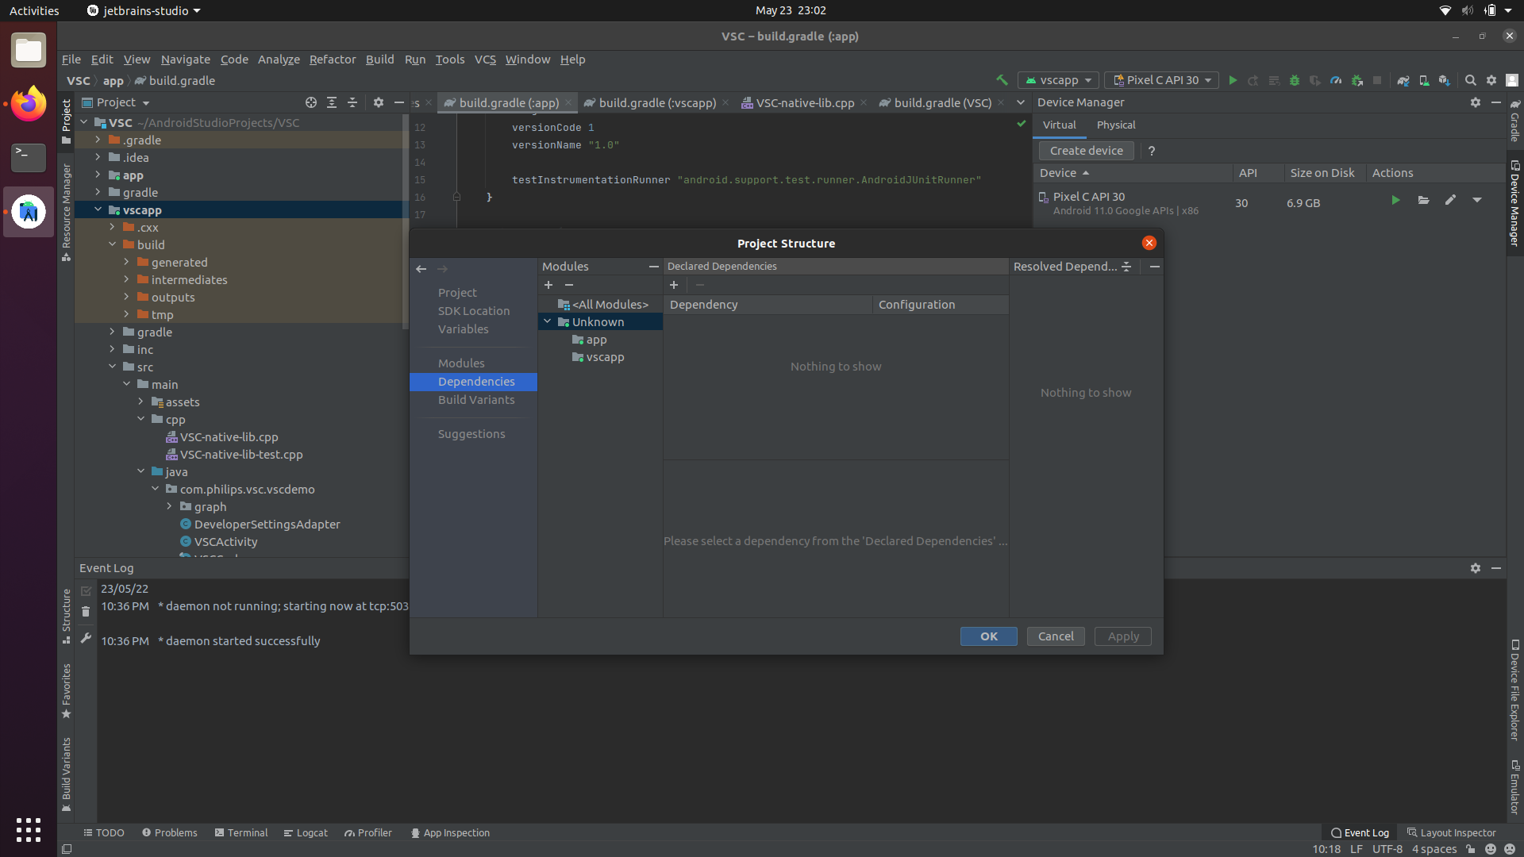

Slide 15
How to use App

Slide 16

Just Downloading……. And Installation
Download the .apk file
Install the app clicking install
Then app will installed it will ask Done or app
The go to Home screen we can open the app.

Slide 17
Conclusion
Vital Sign Camera App is designed app by Phillips.
This App license will be expired soon
Every month we have renew this app
In future we try out making the app into new app with more features and storing capacity also

